Slide 1
Stroke Predictions
Chastity Benton
04/2022

Slide 2
What we will be covering:
Topic/Business Problem:
Questions to cover:
What age is having strokes the most?
Does BMI Affect Chances of Strokes?
Does Glucose Level Affect Chances of Stroke?
Models used to determine predictions
KNN Classifier
Random Forest Classifier
XGBooster
Conclusion

Slide 3
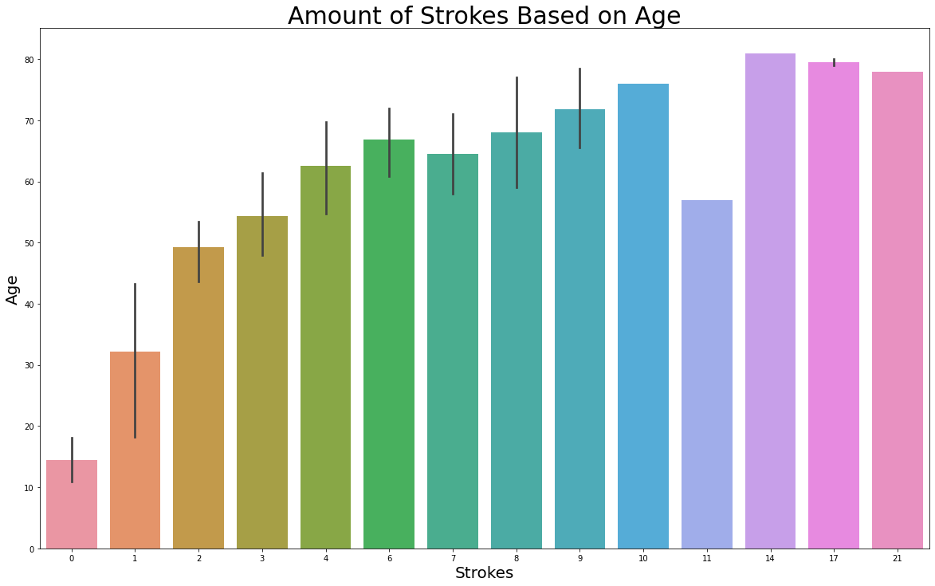
What Age is Having Strokes the Most?
As age increases, the chances for stroke also increases.
55s seems to be a little lower, but this does not change the fact of the data.

Slide 4
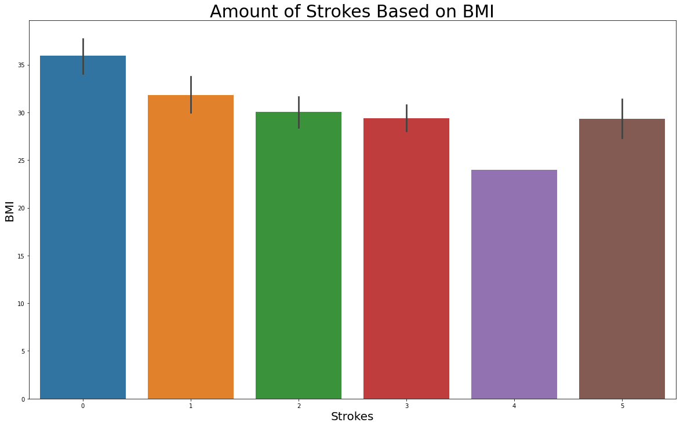
Does BMI Affect Changes of Strokes?
Higher the BMI the higher change of stroke

Slide 5
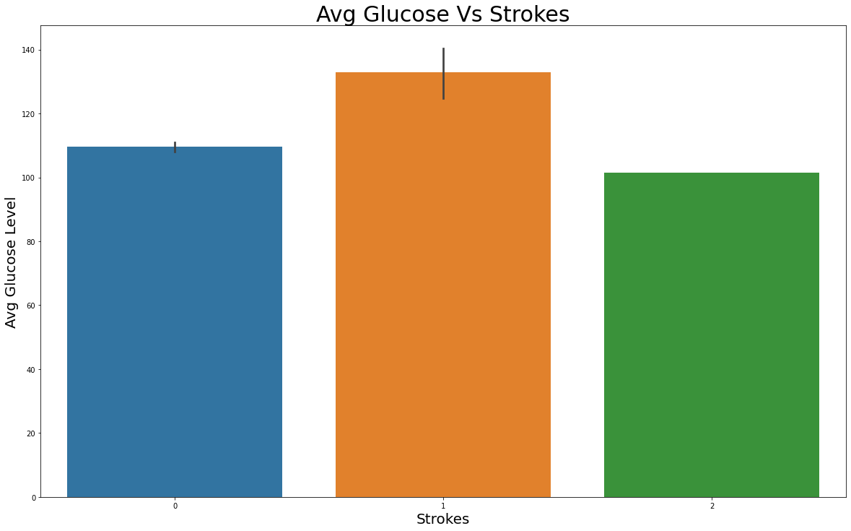
Does Glucose Level Affect Chances for Strokes?
Higher glucose levels can affect the chances of stroke.

Slide 6
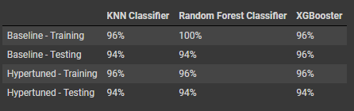
Models used to determine predictions
Notes:
Determine with 94% accuracy if the patient will have a stroke or not based on metabolic issues.
KNN Classifier did not improve much after hypertunning but still proved it can predict chances of stroke on a 94% accuracy. This model takes about 1 hour to run.
Random Forest was initially overfit but after hypertunning, showed promise. This model can also predict a patient’s chance of stroke by 94%. XGBooster would be the best choice here since it has a faster speed, something imperative in the medical field, while still providing high accuracy of 95%.

Slide 7
Conclusion
Summary
Recommendations
Future Tasks
Age, BMI, and glucose levels affect the chances of stroke
Three models were used to predict chances of stroke on potential patients
KNN Classifier
Random Forest Classifier
XGBooster
Pay close attention to the age, BMI, and glucose levels of patients who are at risk of strokes
Use XGBooster model, to predict, with a 94% accuracy, potential patients at risk for strokes.
Be on the lookout for updated metabolic factors to stroke that could be used to further improve predictions
Attempt Neural Network models and see if these provide better predictions in the future

